Slide 1
Training of Trainers Workshop

Slide 2
Learning Contract
Arrive on time and keep to time
Attend all sessions
Cell phones on silent calls made on breaks
Respectful challenge
Participate in activities
Listen when others are speaking
Be responsible for our own learning
Confidentiality
Support the learning of others

Slide 3
What do we mean by reflection?
Looking back at what has happened; learning forward by taking action
Stepping back from ‘doing’
‘…see[ing] yourself…from both the inside and the outside, to question what you are doing, the way you are doing it, why you are doing it’ (Pinder, 2015)

Slide 4
Why should we reflect?
Reflection can increase our competence, understanding and increase our self-esteem, self-confidence, enthusiasm and ultimately, job satisfaction.
As professionals, we have a moral responsibility to update our knowledge and skills and do our best to improve the quality of learning in our training workshops.
We should model good practice in learning.

Slide 5
Why should we reflect?
No two learning situations are the same. Our role is to maximise the learning experience by matching the strategies, materials and resources to the specific culture and context.
Finally, we live in a rapidly changing world. Changes in terms of policy and practice are constants. Reflection and refreshment of ideas is essential.

Slide 6
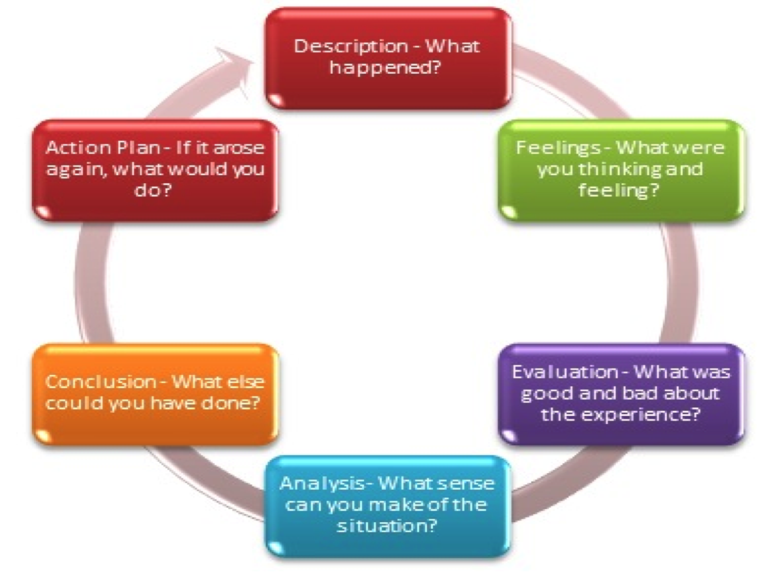
Gibbs Reflective Model

