Slide 1
Training of Trainers Workshop
Insert an image of your choice

Slide 2
Learning Contract
Arrive on time and keep to time
Attend all sessions
Cell phones on silent calls made on breaks
Respectful challenge
Participate in activities
Listen when others are speaking
Be responsible for our own learning
Confidentiality
Support the learning of others

Slide 3
Why do active learning?
Increased content knowledge, critical thinking and problem-solving abilities
Increased enthusiasm for and positive attitude towards learning
Development of critical and creative thinking, problem-solving, communication and interpersonal skills
Improved perceptions and attitudes towards information literacy

Slide 4
Task
Brainstorm as many ‘quick win’ strategies and techniques your colleague can use to develop active learners and stimulate active learning within his training sessions.
Each participant then place three stickers next to the three ideas you would like to introduce straight away into your training or teaching practice.

Slide 5
Task
Which of the strategies and techniques are you already using in your training and/or teaching?
Which could and would you like to introduce into your training and why?

Slide 6
Aims of this presentation
To recognise how the size of groups may impact on the tasks and functions groups are expected to perform during your workshops
To identify the kind of situations different methods of forming groups are useful for
To pool together and evaluate some of the ways to manage reporting back on group discussions

Slide 7
Four methods for forming groups
Preset
Composition wholly or largely determined by trainer in advance based on discipline for example
Structured
Contain a deliberate mix, specifying sorts of people or individuals to be in each group
Random
Participants together largely by chance and know that this is the case
Self-selecting
Participants select which group to join

Slide 8
Task
For what kind of situations are each of the three methods useful for?
Share one example when you used a particular technique to form groups and the reasons why you selected it

Slide 9

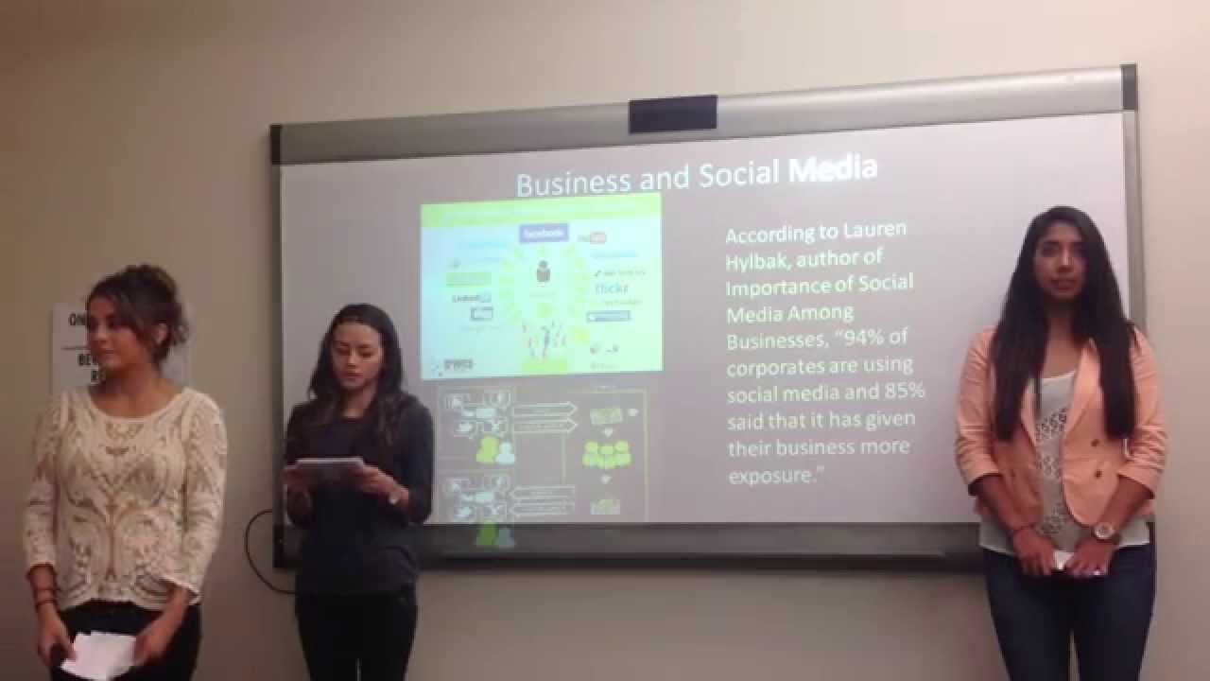
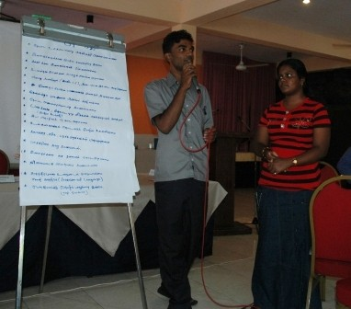
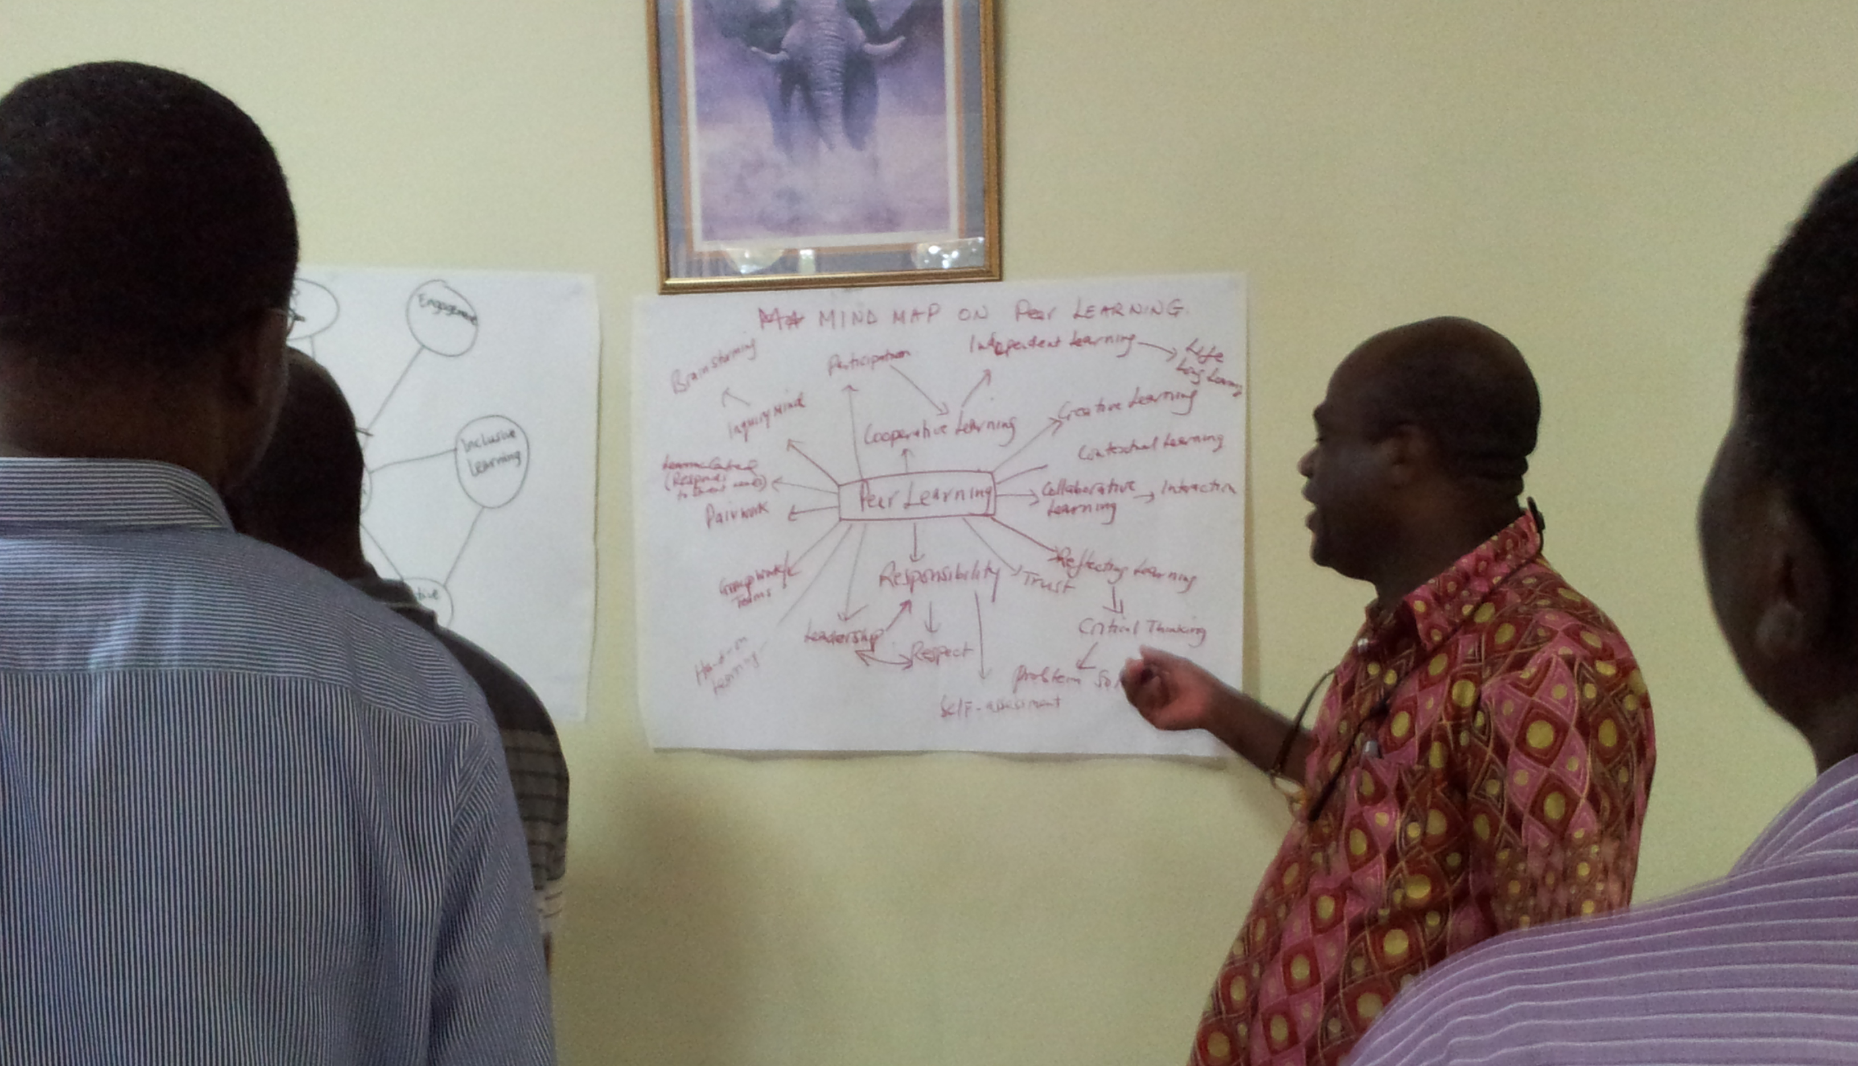
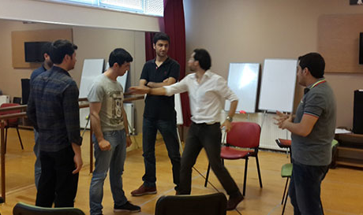
Options for groups reporting back on group work

Slide 10
Task
Think and write your answer to the question below:
Why should I set learning outcomes for my training workshops/courses?
Pair up with a colleague, discuss and compare your ideas.
Share your ideas with the whole group.

Slide 11
Formulating an intended learning outcome
The active verb at the appropriate level of understanding or performance intended;
The topic content the verb is meant to address, the object of the verb in other words;
The context of the content discipline in which the verb is to be deployed.
e.g. describe the key ethical issues in research and publishing

Slide 12
Intended Learning Outcomes
 |  |  |  |  | Creating
 |  |  |  | Evaluating | HIGH
 |  |  | Analyzing
 |  | Applying
 | Understanding
Remembering |  | Level of Thinking
LOW
Based on Anderson and Krathwohl’s Taxonomy, 2001

Slide 13
By the end of the workshop, learners will be able to:
Understand the principles of adult learning
Have a deeper appreciation for good active learning
Evaluate the applicability of strategies and training techniques that promote active learning within the research writing workshop context
Be given opportunities to learn effective facilitation skills

Slide 14
Suggested answer key:
Option/ ILO | Analysis
1-D | Describes program content, not the attributes of successful learners
2-B | Does not start with an action verb or define the level of learning; subject of learning has no context and is not specific
3-A | Starts with an action verb, but does not define the level of learning; subject of learning is still too vague for assessment
4-C | Starts with an action verb that defines the level of learning; provides context to ensure the outcome is specific and measurable

Slide 15
What do you want your participants to learn?
Intended Learning Outcomes
How are you going to help them to learn it?
Training and learning methods and opportunities
How will you know if they have learnt it?
Assessment methods

Slide 16
Task:
What techniques can learners and trainers use during a RW workshop to meaningfully assess learning?
Which levels of thinking are the easiest/ hardest to identify assessment techniques for?
Which of the techniques would you like to try straightaway in your training and/or teaching?

Slide 17
End of day review
One thing that you have learned from today (green)
One question that you have from today (orange)
One suggestion as to how the training or logistics can be improved (yellow)

Slide 18
Insert an image of your choice
This work is licensed under a Creative Commons Attribution ShareAlike 4.0 International licence.
Notes:
You are free to:
Share — copy and redistribute the material in any medium or format
Adapt — remix, transform, and build upon the material for any purpose, even commercially.
The licensor cannot revoke these freedoms as long as you follow the license terms.
Under the following terms:
Attribution — You must give appropriate credit, provide a link to the license, and indicate if changes were made. You may do so in any reasonable manner, but not in any way that suggests the licensor endorses you or your use.
ShareAlike — If you remix, transform, or build upon the material, you must distribute your contributions under the same license as the original.
No additional restrictions — You may not apply legal terms or technological measures that legally restrict others from doing anything the license permits.
Notices:
You do not have to comply with the license for elements of the material in the public domain or where your use is permitted by an applicable exception or limitation.
No warranties are given. The license may not give you all of the permissions necessary for your intended use. For example, other rights such as publicity, privacy, or moral rights may limit how you use the material.
https://creativecommons.org/licenses/by-sa/4.0/

